Slide 1
Programming in C

Slide 2
Hello World
#include <stdio.h>
int main(void)
{
printf("Hello world!!\n");
}

Slide 3
Compiling on student
What do you need to run "Hello World"?
Access to computer with a compiler
Computer
student.cs.appstate.edu
connect with putty
Compiler
GCC The Gnu Compiler Collection

Slide 4
Alternatives to using student
ASNI C is a standard version of C. Any compiler which adheres to ANSI C should give the same output.
Any Linux or Mac can install GCC/G++.
Most implementations of Linux have it already installed
Windows has many C compilers.
mingw is an excellent command line based, windows implementation of gcc or g++.
Dev-C++ is a good development environment.
Use bash on Ubuntu on Windows (See additional slide).
Not being able to get your own computer to compile programs will not be an excuse for not getting assignments completed. I expect you to at least be able to use student; make sure you can.

Slide 5
Connecting to student
PuTTY is a Windows program for connecting to servers running the secure shell protocol (ssh).
http://www.chiark.greenend.org.uk/~sgtatham/putty/download.html
Download putty.exe and save it to your desktop. You don't have to install anything, just click on it.
Linux and Max, open a terminal or shell window and use the ssh command
Type the following
ssh your_user_name@student2.cs.appstate.edu

Slide 6
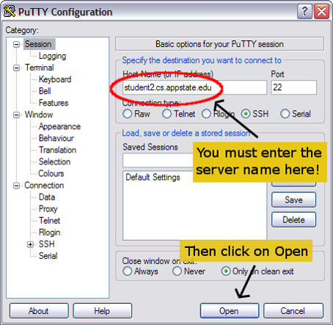
Using puTTY
There are many options you can set on putty.

Slide 7
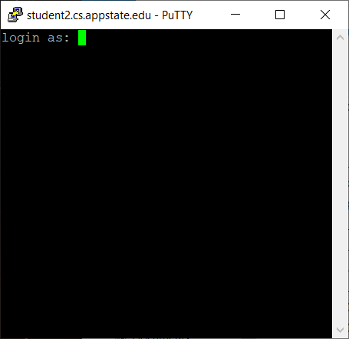
Getting logged in
Use your username exactly as you use on other systems at ASU.
Your password will be your BANNER ID if you have never logged into student.
If you have logged into student you will have to remember your old password. Your AsULearn password will almost definitely not work.
Contact the system administrator if you cannot remember your password.
When you are typing your password, note that no characters show up. This is normal on UNIX system.

Slide 8
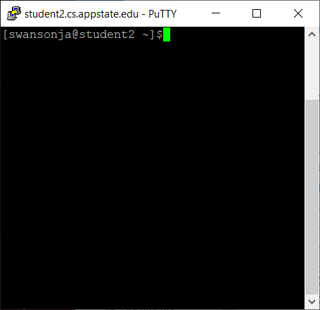
Logged in
If you see a window similar to this you are logged in.
The text on the screen is a command prompt and it is waiting for a command to be entered.

Slide 9
Some UNIX commands
pwd shows you the current folder you are in. The present working directory (pwd).
ls list all files in the pwd.
mkdir create a new directory or folder in the pwd.
cd change to a different folder. That folder must be in the pwd.
cd ~ change back to your home directory.
rm filename removes a file named filename from the pwd.
rm directoryname –f removes an EMPTY directory.
mv oldfilename newfilename - Rename a file.
ctrl – c will kill an out of control process (i.e. infinite loop).
exit – exits the terminal. Quit putty this way, don’t use x at top of window. Always exit your editor and exit putty using exit.

Slide 10
Example Hello World
Log into student.
Make a new directory for 2450.
Change into that directory.
Make a new directory to store C programs.
Change into that directory.
Open an editor and type in the hello world program from slide 2.
Save the program as hello.cc and exit the editor.
Compile the program.
Run the program.

Slide 11
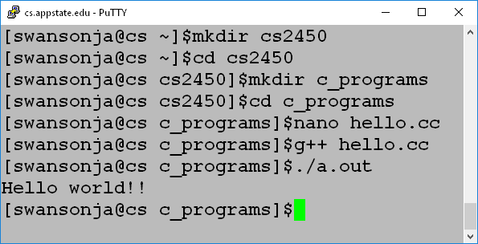
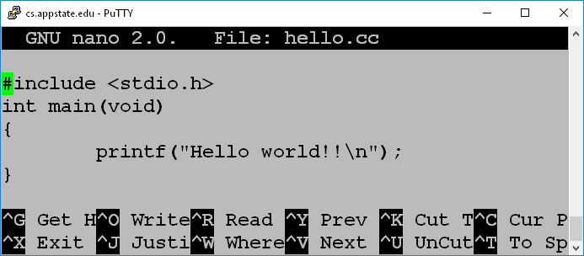
Example implemented
I used nano as an editor. Feel free to use vi/vim, emacs, or any other text editor you are comfortable with.
Control-O (WriteOut) saves from nano. Make sure it is named hello.cc.
Control-X exits.
The default name of the executable file created by gcc is a.out.
You can change the output file name by using the –o option
The above uses gcc to compile. gcc and g++ do the same thing.

Slide 12
Compiling a program
g++ hello.cc
Creates an executablefile named a.out
Run by typing a.out or ./a.out on the command line
g++ -o hello hello.cc
Creates an executable file named hello.
Run by typing hello or ./hello on the command line
g++ -Werror -Wall -o hello hello.cc
Creates an executable file named hello and treats all warnings as errors.
-Werror : Treat warnings as error
-Wall : Show all warnings
-o : Name the output file
(-Werror WILL BE TURNED ON FOR WEB-CAT).

Slide 13
Warnings and Errors
#include <stdio.h>
int main()
{
double a;
printf("Enter a double: ");
scanf("%f", &a); //error should be %lf
printf("%f\n", a);
}
The above will give a warning and compile.
Typing 1.2 at the prompt will result in 0.00000 as output.
-Werror will make sure this doesn’t happen.

Slide 14
Assignments
Assignments will be broken into two parts.
You will create a file named main.cc with a main method in it. Sometimes I will give you this file.
You will create separate file with your program code. The program code will be a series of functions. DO NOT PUT A MAIN IN YOUR CODE FILE.
Web-CAT uses a main method to test your code. If your code already has a main method it will fail.
Note that we are learning C even though we are using C++ to compile.
For this class you are NOT allowed to use the C++ language.
Most specifically you are not allowed to use CIN or COUT.
You are only allowed to use code as shown in my slides or the book.

Slide 15
Submitting to Web-CAT
Submitting
Go to the Web-CAT web page
http://webcat.cs.appstate.edu
Select the assignment
Upload
Grading
You will be graded according to the number of tests that you pass.
You will lose points for excessive submissions
You will lose points for every day the assignment is late.
You will receive a 0 if the assignment is more than 2 days late.

Slide 16
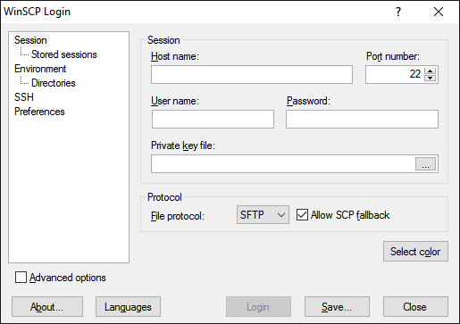
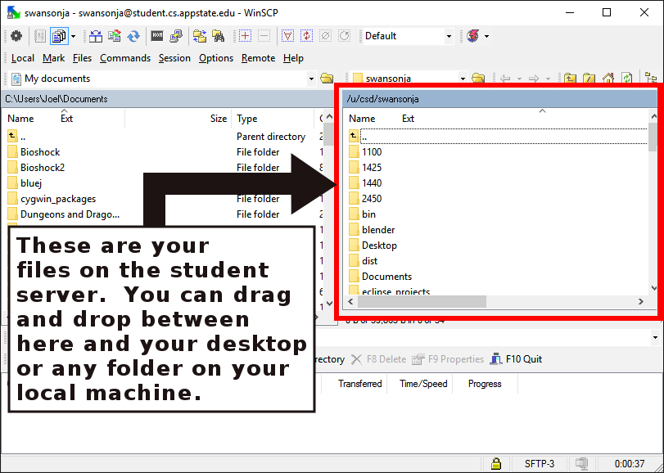
Getting files from Student
Windows users can use WinSCP.
Host name: student.cs.appstate.edu
Enter your user name and password.
Note that your password is your password on the student server and NOT your AsULearn password.

Slide 17
Linux and Mac use SCP
Assuming
I have a folder named 2450 with a folder named assign1 inside on student.
My PWD is my assign1 directory on the local machine
Copy file TO student FROM the local machine.
scp assign1.cc swansonja@student2.cs.appstate.edu:2450/assign1/assign1.cc
Copy assign1.cc FROM student TO the local machine
scp swansonja@student2.appstate.edu:2450/assign1/assign1.cc assign1.cc

Slide 18
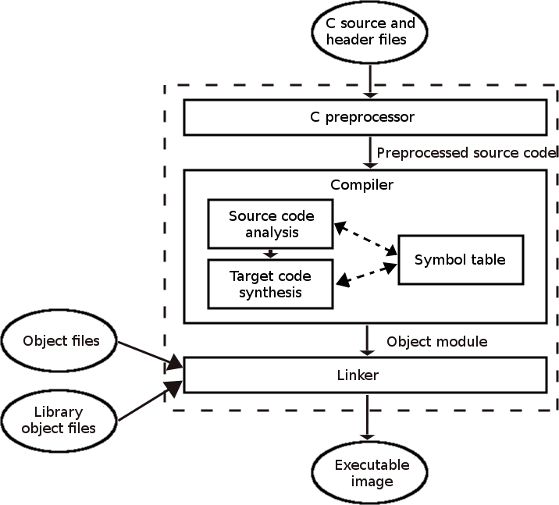
Compiling Details

Slide 19
Part of the compiler
Preprocessor – Processes directives
Directive start with the # symbol.
#include will copy the named file into the source code buffer.
#define will replaced any instance of the constant with the value specified in the entire source code buffer.
Output is preprocessed source code.
Compiler – Convert code to assembly language and track variable names in the symbol table. This portion will attempt to optimize code. The symbol table is a mapping of the variable names to memory locations actually used.
Output object code – Not all addresses resolved.
Linker – Determines and inserts the addresses for any external code that is needed such as code for building and displaying windows.
Output is executable code ready to be executed by the hardware.
GCC seems to do all of the above in one step, but it actually performs each step separately.

Slide 20
C and Java
I am assuming you know Java.
Java and C are similar in syntax.
Methods are called functions but are otherwise declared and used the same. There is no public or private, however.
The "main" function is where code operation begins.
if and while work the same.
Operators all act the same.
for loops act the same (In older versions of C you must declare loop control variables before the loop).

Slide 21
Homework 6 – Loops and shapes
Since most of the statements and concepts from this first assignment are almost exactly the same as Java you should be able to figure it out.
If not, ask.

Slide 22
Variables
Three basic primitive types – work the same as java
int
char
double
No String as a type.
Local variables – defined in methods.
Global variables – defined outside of methods. Similar to fields in that they are available to all functions. Global variables, however, are available to the entire program, like a public field, and should be used sparingly.
ALWAYS use local variables and parameter passing where possible instead of global variables.
ALWAYS initialize your variables. Local variables are NOT initialized to zero in C.

Slide 23
Integer types
Type | Size | Range
char | 1 byte | -128 to 127 or 0 to 255
unsigned char | 1 byte | 0 to 255
signed char | 1 byte | -128 to 127
short | 2 bytes | -32,768 to 32,767
unsigned short | 2 bytes | 0 to 65,535
int | 4 bytes | -2,147,483,648 to 2,147,483,647
unsigned int | 4 bytes | 0 to 4,294,967,295
long | 8 bytes | -2,147,483,648 to 2,147,483,647
unsigned long | 8 bytes | 0 to 4,294,967,295

Slide 24
Floating Point Types
Type | Size | Range | Decimal Places
float | 4 byte | 1.2E-38 to 3.4E+38 | 6
double | 8 byte | 2.3E-308 to 1.7E+308 | 15
long double | 16 byte | 3.4E-4932 to 1.1E+4932 | 19

Slide 25
#include <stdio.h>
int main()
{
char b = 1;
printf("%d\n", b); //Prints 1
b = -1;
printf("%d\n", b); //Prints -1
b = 128;
printf("%d\n", b); //Prints -128
b = 0xff;
printf("%d\n", b); //Prints -1
b = 0xf0;
printf("%d\n", b); //Prints -1
b = 165;
printf("%d\n", b); //Prints -91
b = 1.5;
printf("%d\n", b); //Prints 1
b = 'c';
printf("%d\n", b); //Prints 99
}

Slide 26
Declaring variables
The same as Java
double width;
double pType = 9.44;
double mass = 6.34E2;
double verySmall = 0.1094E-31;
int average = 12;
int windChill = -21;
int unknownValue;
char initial = 'A';
char num4 = '4';

Slide 27
Declaring constants as #define
Constants
#define LETTER '1'
#define ZERO 0
#define NUMBER 123
Constants do not have a type.
The text will simply replace the constant identifier in the source code during the preprocessor phase before compiling begins.

Slide 28
Operators same as Java
The following are the same as Java.
Operators and Expressions. (+, -, *, /, %, a + b)
Assignment (x = a + b)
Parenthesis ((a+b)*x)
Increment and decrement (++, --)
Combined operators (+=, -=, *=, etc…)

Slide 29
Order of Operation
Precedence | Associativity | Operators
1 | L to R | () (function call) [ ] (array index) ->
2 | R to L | ++ -- (postfix versions)
3 | R to L | ++ -- (prefix versions)
4 | R to L | *(indirection) &(address of) +(unary) –(unary) ~ ! sizeof
5 | R to L | (type) (type cast)
6 | L to R | * (multiplication) / %
7 | L to R | + (addition) - (subtraction)
8 | L to R | << >>
9 | L to R | < > <= >=
10 | L to R | == !=
11 | L to R | &
12 | L to R | ^
13 | L to R | |
14 | L to R | &&
15 | L to R | ||
16 | L to R | ? : (conditional expression)
17 | R to L | = += -= *= /= %= &= |= ^= <<= >>=

Slide 30
Relational and Conditional Operators
DIFFERENT THAN JAVA
C has no Boolean data type.
Technically
0 is false
anything not zero is true
3 == 5 evaluates to 0
3 != 5 evaluates to 1

Slide 31
Tricky Error
The following code will print the word same.
In java it would have produced an error.
Be careful about accidentally using = instead of ==
int x = 5;
int y = 7;
if ( x = y )
{
printf("Same");
}

Slide 32
Tricky Logical Operators
int f = 7;
int g = 8;
int h;
h = f & g;
h = f && g;
h = f | g;
h = f || g;
h = ~f | ~g
h = !f && !g;
h = 29 || - 52;

Slide 33
If and While
The following work the same as Java.
if
if-else
if-else-if
if-else-if-else
while
do-while

Slide 34
printf
No print or println, only printf
Similar to Java printf
%[flags][width][.precision][length]specifier
Specifiers (some of them)
c – character (Display the character for an ASCII value)
d or i – Signed integer
e or E – Scientific notation
f – floating point
s – string of characters (null terminated)
u – unsigned integer
x or X – unsigned hexadecimal (lower or upper case)
p – pointer address
n - nothing

Slide 35
printf flags and width
%[flags][width][.precision][length]specifier
Flags
- Right justify
+ Include plus sign for positive numbers
0 Left pad number with zeros. Only for numbers with width specified.
Width Minimum number of spaces
* specify width as an additional integer value argument

Slide 36
printf precision and length
%[flags][width][.precision][length]specifier
.precision
.num The number of decimal points to display.
.* The number of decimal points is specified as an additional integer value argument
length used for different sizes of integers or doubles (i.e. long or short)
h, l, or L

Slide 37
Functions
Functions follow the same rules as Java.
No public or private though.
Return types the same.
Use void type if there is no return.
Use return statement to return values and exit the function.
Passing parameters the same except
Pointers allow call by reference for primitive types.
More on this later.
Creating functions
int get2Times (int x) {
return x * 2;
}
void print2Time(int x) {
printf("%dx2=%d\n", x, x*3);
}
Using functions
int y = get2Times(5);
print2Times(4); //Prints 4x2=8

Slide 38
Pointers
In Java, object variables reference the object they are storing.
The variable holds the memory location or reference of the position in memory where the object was created.
In C, we can have references to any variable.
Using pointers incorrectly can have unpredictable results and cause hard to diagnose errors.
Java does not allow user created reference variables.

Slide 39
Pointer operations
Declare a variable named ptr which is a pointer to an integer.
* - dereference - Read as "star" or "splat"
& - "address of" operator
int count = 5;
int *ptr;
ptr = &count;
*ptr = *ptr + 1;
printf("%i", count);

Slide 40
Getting an address
& returns the address of a variable.
int count = 5;
&count - returns the address that C has allocated to the variable count.

Slide 41
Pointer Example
int count1 = 1;
int count2 = 3;
int count3 = 5;
int *ptr;
int main() {
ptr = &count1;
printf("%i - %i - %i\n", count1, count2, count3);
for (int i = 0; i < 3; i++) {
*ptr = *ptr + 1; // could use (*ptr)++;
printf("%d - %d - %d\n", count1, count2, count3);
ptr = ptr + 1;
}
}

Slide 42
Scanf
Input – Similar to printf with formats
%[*][width][modifiers]type
The variable must be a reference or pointer.
int x;
scanf("%d", &x);

Slide 43
Scanf Format
%[*][width][modifiers]type
Formats should be simple.
Don't print prompts using the scanf format.
PROMPT LIKE THIS THIS:
int x;
printf("Enter an integer: ");
scanf("%d", &x);
DON’T PROMPT LIKE THIS:
int x;
scanf("Enter an integer: %d", &x);

Slide 44
Scanf and Spaces
scanf uses any whitespace character (tabs, spaces, newlines) as a delimiter.
That means scanf will not read past a space unless you tell it to.
The following will read 99 characters into test and will not stop until a newline (enter) is reached.
char test[100];
scanf("%99[^\n]", test);

Slide 45
Use multiple Scanf
Get multiple variables with multiple scanfs
int x, y;
printf("Enter an integer: ");
scanf("%d", &x);
printf("Enter another integer: ");
scanf("%d", &y);
Don't do this:
int x, y;
printf("Enter two integers: ");
scanf("%d %d", &x, &y);

Slide 46
Scanf Example
int i = 0;
float f = 0;
double d = 0.0;
char c = ' ';
printf("Enter an integer: ");
scanf("%d", &i);
printf("Enter a float: ");
scanf("%f", &f);
printf("Enter a double: ");
scanf("%lf", &d); //Note lf (long float)
printf("Enter a character: ");
scanf("%c", &c);
scanf("%c", &c); //Why two scanfs?
printf("%i - %f - %f - %c\n", i, f, d, c);

Slide 47
Another scanf example
int num1 = 0;
double num2 = 0;
printf("I will sum two numbers for you.\n");
printf("Enter an integer: ");
scanf("%d", &num1);
printf("Enter a double: ");
scanf("%lf", &num2); //note the lf (long float for doubles)
printf("%d + %.2f = %.2f\n", num1, num2, num1 + num2 );
return 0;

Slide 48
Warnings and Errors
#include <stdio.h>
int main()
{
double a;
printf("Enter a double: ");
scanf("%f", &a); //error should be %lf
printf("%f\n", a);
}
The above will give a warning and compile.
Typing 1.2 at the prompt will result in 0.00000 as output.

Slide 49
Arrays
Logically you can think of arrays in C the same way as you think of them in Java.
The reality is that arrays are objects in Java and simply a large group of declared variables in C.
int grid[10];
double scores[15];
char name[30];
In the above examples grid, scores, and name are simply pointers to the first element in the array
Unlike pointers, however, grid, scores and name cannot be reassigned.
Array size MUST be known at compile time. You cannot use an undefined variable to create an array.

Slide 50
Array Length
There is no way to determine the number of items in an array once it is created so it is vitally important to keep track.
A good practice is to use a constant for the number of items you wish to store.
#include <stdio.h>
#define NUM_GRADES 10
int main()
{
int grades[NUM_GRADES];
int i = 0;
for (i=0; i < NUM_GRADES; i++)
{
printf("Enter grade #%2d: ", i+1);
scanf("%d", &grades[i]);
}
double avg = getIntArrayAverage(grades, NUM_GRADES);
printf("Average: %.2f\n", avg);
}

Slide 51
getIntArrayAverage
double getIntArrayAverage(int grades[], int num)
{
}
//You could use NUM_GRADES here, but don't.
//For my assignments, always pass in the number of items
//and use the parameter. Don’t assume I will use the same constant.

Slide 52
Passing Arrays as Parameters
Note the important pieces of the last two slides.
In main:
int grades[NUM_GRADES];
//fill in the grades with some code of course
double avg = getIntArrayAverage(grades, NUM_GRADES);
In getIntArrayAverage:
double getIntArrayAverage(int grades[], int num)
//Note the brackets [ ] are left empty.
//Variable grades here is actually an int pointer.

Slide 53
Dynamic Arrays
void* calloc(size_t num, size_t size)
reserves num * size bytes of memory
initializes memory to zero.
void free(void *ptr) – gives the memory back
You are in charge of the memory used. Make sure to free anything you don’t need.

Slide 54
Dynamic Arrays
// Allocate and return an array of 'n' integers
// Returns NULL on failure
// MUST RETURN A POINTER TO THE NEW MEMORY
int *myFunc(int n) {
int i;
// allocate block of memory
int *x = malloc(n * sizeof(int));
// test allocation for success
if (x == NULL) {
return NULL;
}
// fill it with zeros
for (i=0; i<n; i++) {
x[i] = 0;
}
// return the pointer
return x;
}

Slide 55
Using Dynamic Arrays
int checkGetIntArrayAverageRandom()
{
int n = rand() % 8 + 5;
int *a = (int*)calloc(n, sizeof(int));
for (int i = 0; i < n; i++)
{
a[i] = rand() % 25 - 5;
}
double exp = getIntArrayAverageAns(a, n);
int retVal = checkGetIntArrayAverage(a, n, exp);
free(a);
return retVal;
}

Slide 56
Strings
Strings in C are arrays of characters.
You must know the maximum length before creating a string so the array can be created of the correct size.
Strings in C must be null terminated. That is the last character must be a null or zero (\0).
You must reserve space for the null zero.

Slide 57
String example
char name[10] = "BILL"; //Null zero added
char *name = "BILL"; //Null zero added
B
I
L
L
\0
name
name is a char pointer
which contains the address
of the first char in the array
Not the character 0.
The number zero is
stored here.

Slide 58
Some Differences
char a[10] = “aaaaa”;
char *b = “bbbbb”;
a = “ccccc”; //Not allowed
b = “ccccc”; //allowed
a++; //not allowed
b++; //allowed
a[5] = ‘x’; //allowed
b[5] = ‘x’; //not allowed
The last one will compile but will give segmentation fault in LINUX since string literals are stored as read only.

Slide 59
String Pointers
Strings literals are stored in their own special memory.
char *b =“123”;
char c = ‘X’;
b = “9999999999”;
printf(“%c\n”, c);

Slide 60
Reading Strings with scanf
char first[15];
char middle[15];
char last[20];
printf("Enter your first name: ");
scanf("%14s", first); //The number tells scanf how many chars to read.
printf("Enter your middle name: ");
scanf("%14s", middle);
printf("Enter your last name: ");
scanf("%19s", last);
printf("%s, %s %s\n", last, first, middle);

Slide 61
Scanf Overflow Protection
#include <stdio.h>
#include <string.h>
char a[6] = "Hello";
char b = 'X';
int main()
{
//Enter 12345, prints a=12345:b=X
//Enter 123456 prints a=123456:b= (X overwritten)
//Enter 123456789 prints a=123456:b= (6 chars max, X overwritten)
scanf("%6s", a); //Should use a 5 here
printf("a=%s:", a);
printf("b=%c\n", b);
}

Slide 62
String Length
size_t strlen(const char *str)
Computes the length of the string str up to but not including the terminating null character.
Can you write this function.

Slide 63
String Copy
char *strcpy(char *dest, const char *src)
Copies the string pointed to, by src to dest.
char *strncpy(char *dest, const char *src, size_t n)
Copies up to n characters from the string pointed to, by src to dest.

Slide 64
String Concatenation
char *strcat(char *dest, const char *src)
Appends the string pointed to, by src to the end of the string pointed to by dest.
char *strncat(char *dest, const char *src, size_t n)
Appends the string pointed to, by src to the end of the string pointed to, by dest up to n characters long.

Slide 65
String Compare
int strcmp(const char *str1, const char *str2)
Compares the string pointed to, by str1 to the string pointed to by str2.
int strncmp(const char *str1, const char *str2, size_t n)
Compares at most the first n bytes of str1 and str2.
These functions return values that are as follows:
if Return value < 0 then it indicates str1 is less than str2.
if Return value > 0 then it indicates str2 is less than str1.
if Return value = 0 then it indicates str1 is equal to str2.

Slide 66
String Search
char *strstr(const char *haystack, const char *needle)
Finds the first occurrence of the entire string needle (not including the terminating null character) which appears in the string haystack.
char *strrchr(const char *str, int c)
Searches for the last occurrence of the character c (an unsigned char) in the string pointed to by the argument str.

Slide 67
String Tokenizing
char *strtok(char *str, const char *delim)
Breaks string str into a series of tokens separated by delim.
Every time you call strtok, it returns a pointer to the next character after delim.
Returns null when no more tokens are available.

Slide 68
int main()
{
char str[80] = "This is - www.tutorialspoint.com - website";
const char s[2] = "-";
char *token;
/* get the first token */
token = strtok(str, s);
/* walk through other tokens */
while( token != NULL )
{
printf( " %s\n", token );
token = strtok(NULL, s);
}
return(0);
}

Slide 69
String Functions Example
char *s1 = "Tomorrow";
char s2[100] = "";
char *s3;
printf("Length of \"%s\" is %ld.\n",s1, strlen(s1));
strncpy(s2, "Testing", 100);
strncat(s2, " 1 2 3", 100 - strlen(s2));
printf("Length of \"%s\" is %ld.\n",s2, strlen(s2));
s3 = strchr(s1, 'r');
printf("s3 is %s.\n",s3);
s3 = strstr(s1, "ro");
printf("s3 is %s.\n",s3);
printf("Comparing \"%s\" and \"%s\" gives %d\n",
s1, s2, strncmp(s1, s2, 100));
printf("Comparing \"%s\" and \"%s\" gives %d\n",
s2, s1, strncmp(s2, s1, 100));
printf("Comparing \"%s\" and \"%s\" gives %d\n",
s1, "Tomorrow" , strncmp(s1, "Tomorrow", 100));
Length of "Tomorrow" is 8.
Length of "Testing 1 2 3" is 13.
s3 is rrow.
s3 is row.
Comparing "Tomorrow" and "Testing 1 2 3" gives 10
Comparing "Testing 1 2 3" and "Tomorrow" gives -10
Comparing "Tomorrow" and "Tomorrow" gives 0

Slide 70
Structures
Like a class in Java, but only for data (no functions).
Use typedef struct to create outside of any method.
typedef struct {
char last[NAME_SIZE];
char first [NAME_SIZE];
double gpa;
int startYear;
} student_t;
The above sets up a new type (student_t) which can hold first name, last name, gpa, and starting year for a student.
Unlike object is Java, structures are copied when passed as parameters.

Slide 71
Using Structures
student_t s1, s2;
strncpy(s1.first, "Bill", NAME_SIZE);
strncpy(s1.last, "Gates", NAME_SIZE);
s1.gpa = 2.2;
s1.startYear = 1990;
s2 = s1;
printf("NAME: %s %s GPA: %f\n", s2.first, s2,
last, s2.gpa);

Slide 72
Pointers to Structures
student_t s1;
student_t *sptr;
strncpy(s1.first, "Bill", NAME_SIZE);
strncpy(s1.last, "Gates", NAME_SIZE);
s1.gpa = 2.2;
s1.startYear = 1990;
sptr = &s1;
*sptr.gpa = 2.3; //Wont compile
(*sptr).gpa = 2.3; //Will work
sptr->gpa = 2.3; //Will work

Slide 73
#include <stdio.h>
#include <string.h>
#define NAME_SIZE 80
typedef struct {
char first[NAME_SIZE];
char last [NAME_SIZE];
double gpa;
int startYear;
} student_t;
int main() {
student_t s1, s2;
student_t *sptr;
strncpy(s1.first, "Bill", NAME_SIZE);
strncpy(s1.last, "Gates", NAME_SIZE);
s1.gpa = 2.2;
s1.startYear = 1990;
s2 = s1;
printf("NAME: %s %s GPA: %f\n",
s2.first, s2.last, s2.gpa);
sptr = &s1;
//*sptr.gpa = 2.3;
(*sptr).gpa = 2.3;
printf("NAME: %s %s GPA: %f\n",
sptr = &s2;
sptr->gpa = 2.4;
printf("NAME: %s %s GPA: %f\n",
s2.first, s2.last, s2.gpa);
return 0;
}

Slide 74
Arrays of Structures
void getStudents(student_t students[])
{
char name[NAME_SIZE];
for (int i = 0; i < NUM_STUDENTS; i++)
{
printf("Enter first name:");
scanf("%s", name);
strncpy(students[i].first, name, NAME_SIZE);
//Other inputs
}
}
void printStudents(student_t students[])
{
for (int i = 0; i < NUM_STUDENTS; i++)
{
printf("Name: %s %s\n",
students[i].first, students[i].last);
}
}
int main()
{
student_t students[NUM_STUDENTS];
getStudents(students);
printStudents(students);
}

Slide 75
Function Order
Functions should be declared before use in a file.
In main, the call to printNum(1) causes a warning.
If functions called are in another file (like our assignments) this will be an error.
int main() {
printNum(1);
}
void printNum(int n) {
printf("%i\n", n);
}

Slide 76
Function Order Better
Functions should be declared before use in a file.
Explicit declaration of a function using a prototype
void printNum(int n); //Prototype
int main() {
printNum(1);
}
void printNum(int n) {
printf("%i\n", n);
}

Slide 77
Prototype Example
This is main.cc
printChars and printRect are two functions declared in another file.
But main has to know about them to compile correctly.
#include <stdio.h>
void printChars(int n, char c);
void printRect(int l, int w, char c);
int main()
{
printChars(7,'X');
printf("\n");
printRect(5,8,'O');
return 0;
}

Slide 78
Functions and Parameters
Pass by value
Argument is copied to new variable.
Changes in function do not affect original variable.
Pass by reference
Argument is reference to the argument.
Changes refer back to original variable and therefore changes are seen in the original.

Slide 79
By Value vs By Reference
int main() {
int x = 5;
decArg1(x);
printf("%d", x);
decArg2(&x);
printf("%d", x);
}
void decArg1(int x) {
x = x - 1;
}
void decArg2(int *x) {
*x = *x - 1;
}

Slide 80
stdlib.h
int atoi(const char *str)
converts string to integer.
double atof(const char *str)
converts string to double
int rand(void)
Returns a number from 0 to RAND_MAX
void srand(unsigned in seed)
Seeds the random number generator
void *malloc(size_in_bytes) and void *calloc(#items, size_of_one_item)
Assign or allocate dynamic memory
free(void *ptr)
Deallocate memory
void exit(int status)
Causes a normal program termination
void abort(void)
Causes an abnormal program termination

Slide 81
Random Numbers
#include <stdio.h>
#include <stdlib.h>
#include <time.h>
int main() {
int i, n;
time_t t;
n = 5;
srand((unsigned) time(&t));
for( i = 0 ; i < n ; i++ ) {
printf("%d\n", rand() % 50);
}
return(0);
}
}

